Slide 1
Pwalugu Multipurpose Dam Project
Website Draft

Slide 2
DESIGN 1

Slide 3
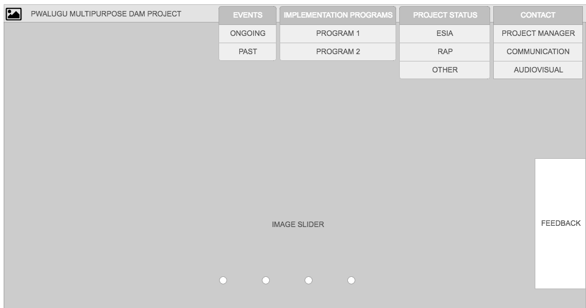
HOME PAGE
Images of dam project which lead to a specific page on website

Slide 4
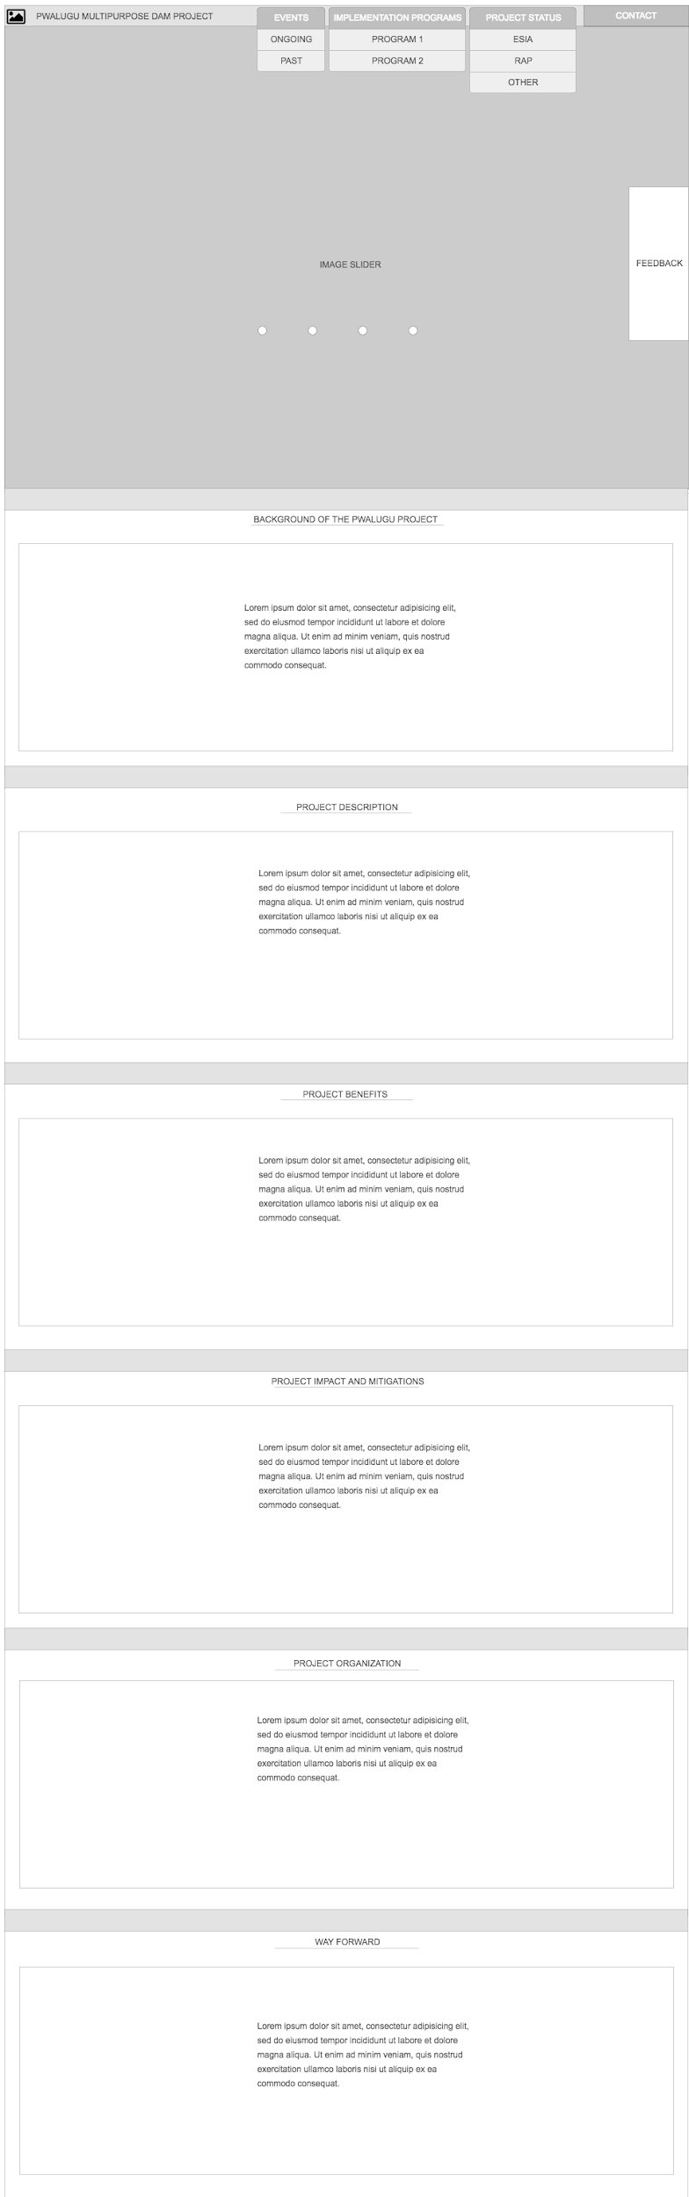
HOME PAGE CONTINUE
HOME PAGE

Slide 5

ONGOING EVENTS PAGE
Event Image &
caption

Slide 6

ONGOING EVENT DETAILS PAGE
Event image

Slide 7

PAST EVENT PAGE
Event Image &
caption

Slide 8

IMPLEMENTATION PROGRAM PAGE

Slide 9

PROJECT STATUS PAGE

Slide 10

PROJECT STATUS PAGE
Status info

Slide 11
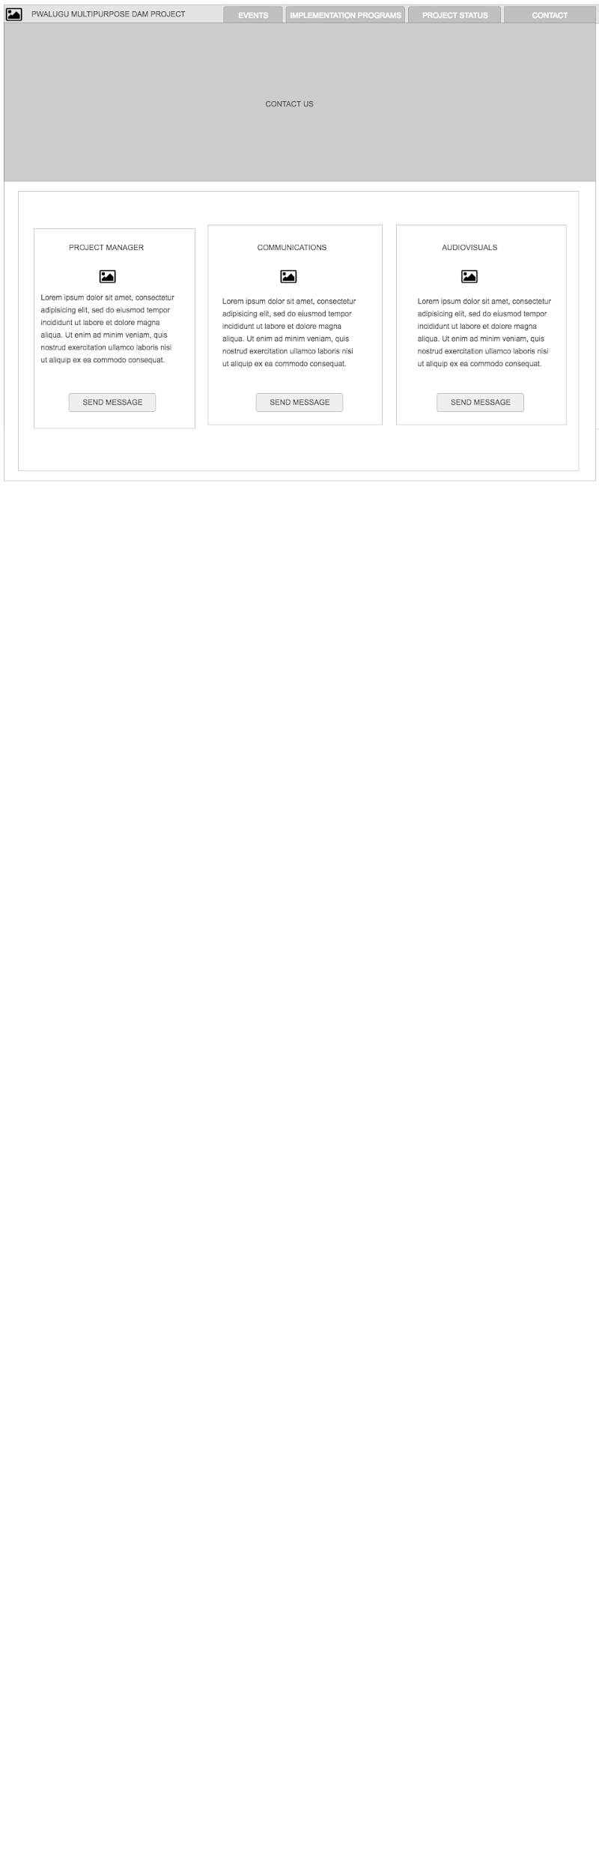
CONTACT PAGE

Slide 12
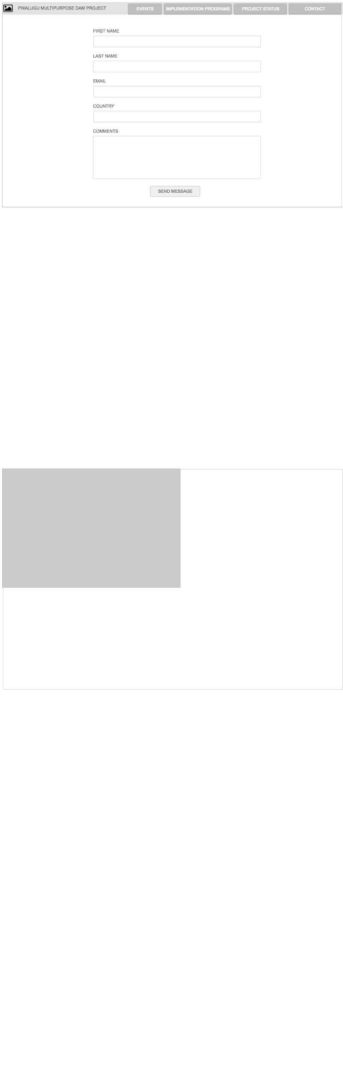
CONTACT FORM PAGE

Slide 13
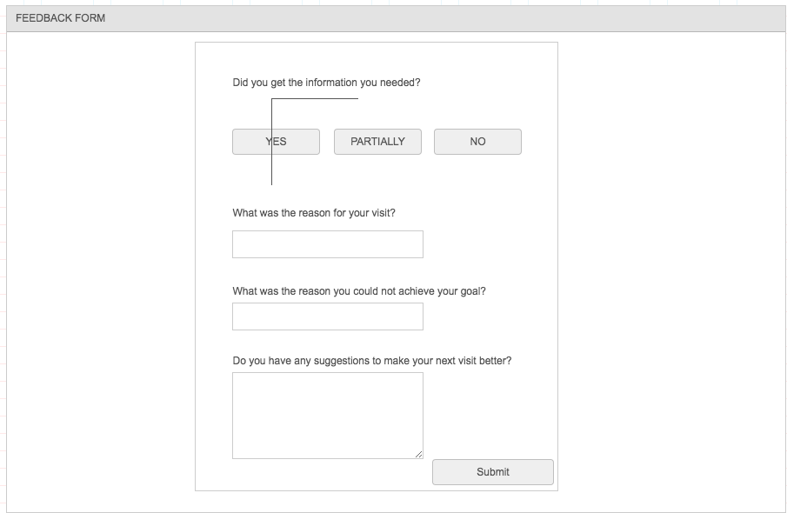
FEEDBACK FORM

Slide 14
DESIGN 2

Slide 15
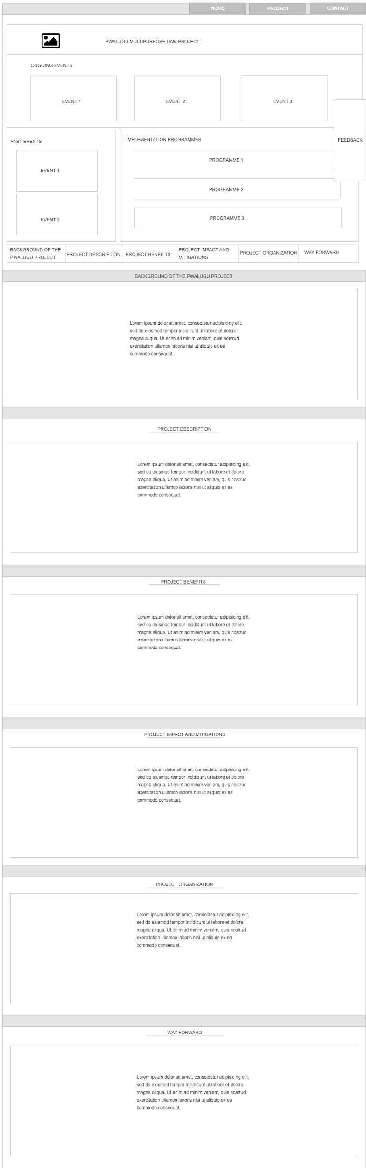
HOME PAGE

Slide 16
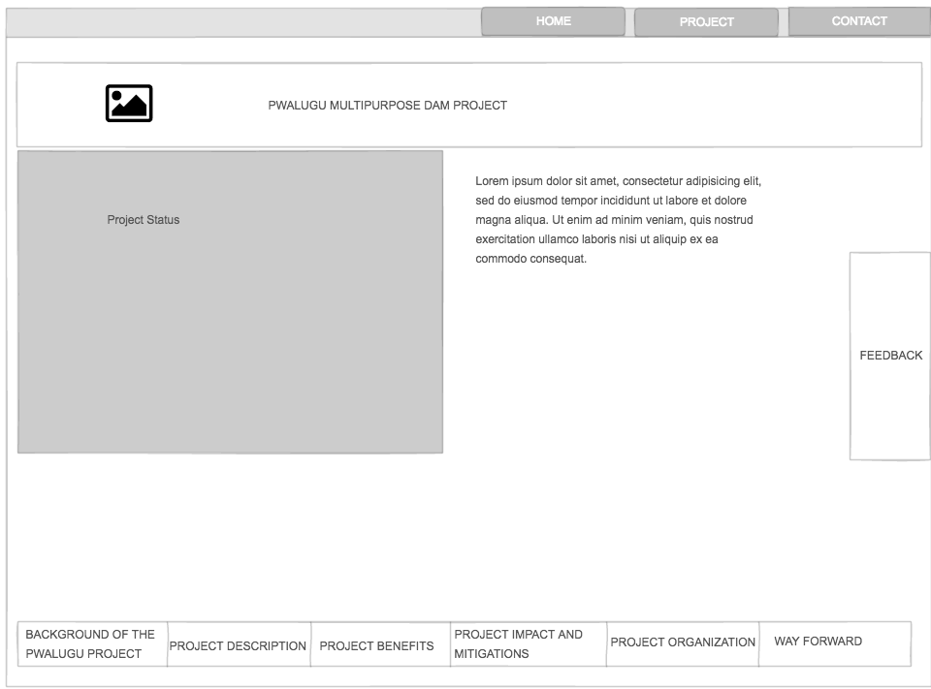
EVENT DETAILS PAGE (ONGOING/PAST)
Event image

Slide 17
IMPLEMENTATION PROGRAM PAGE

Slide 18
PROJECT PAGE
Implementation program page

Slide 19
CONTACT PAGE

Slide 20
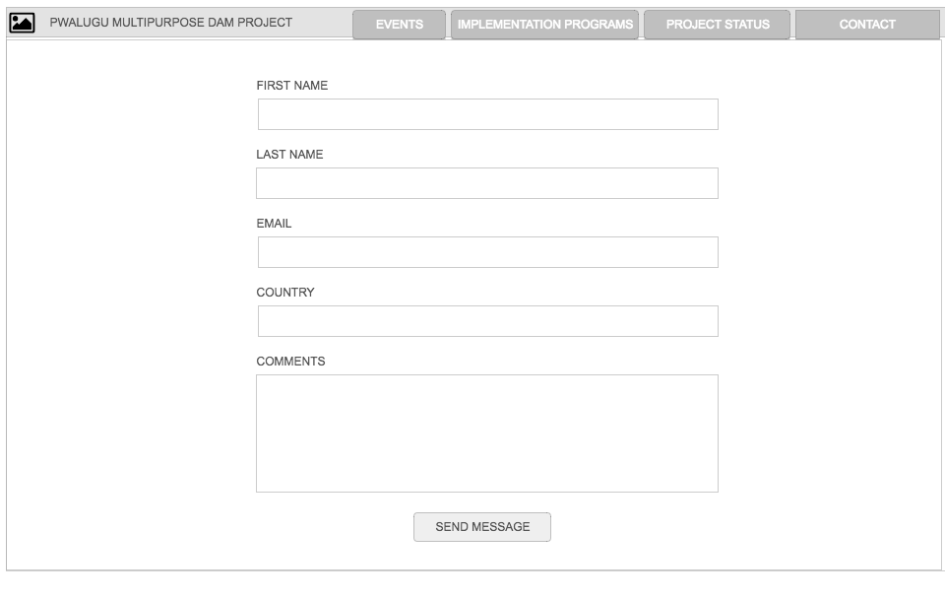
CONTACT PAGE

Slide 21
FEEDBACK FORM PAGE

Slide 22
WEBSITE DOMAIN SUGGESTION
www.pwamdoproject.vra.com
www.pwalugumdp-vra.com
www.pmdprojectvra.com
www.pwaluguvra.com

